Slide 1
Simple Calculator Using Tkinter
A Python GUI Application
- Deepali Daulat Chaugule

Slide 2
Introduction
This presentation covers the creation of a simple calculator using the Tkinter library in Python.
The calculator performs basic arithmetic operations and features a graphical user interface (GUI) with buttons for digits and operations.

Slide 3
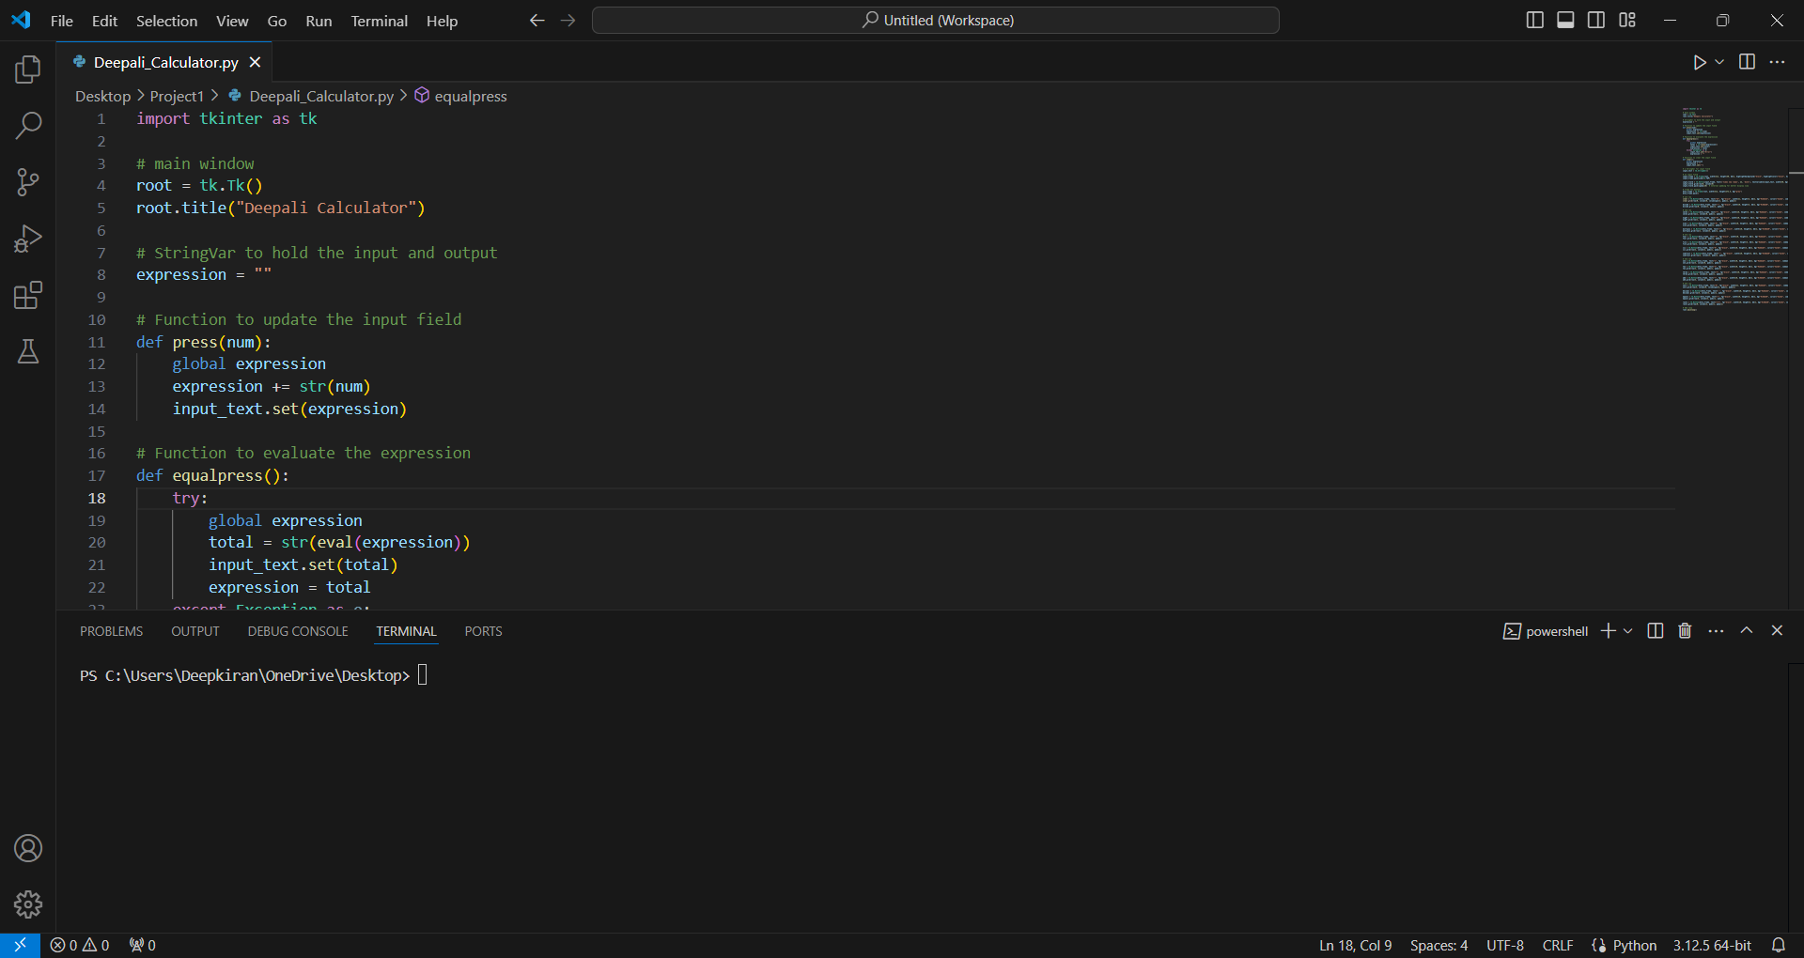
Step 1 Import Libraries and Initialize
1. Import Tkinter library with alias 'tk'.
2. Create the main window using tk.Tk().
3. Set the window title using root.title().
4. Initialize a variable to store the calculator input expression.

Slide 4
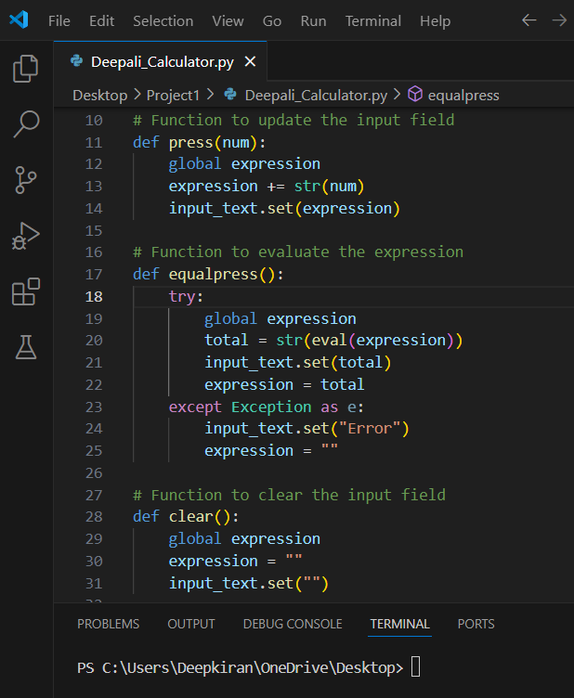
Step 2 Create Functions for Operations
1. `press(num)`: Updates the input expression and displays it.
2. `equalpress()`: Evaluates the input expression and displays the result or error.
3. `clear()`: Clears the input expression and display.

Slide 5
Step 3 Setting Up the GUI Layout
1. Create an input field using `tk.Entry` to display the input and result.
2. Create buttons for digits (0-9) and operations (+, -, *, /).
3. Use Tkinter's `grid()` method to organize the buttons in a grid layout.

Slide 6
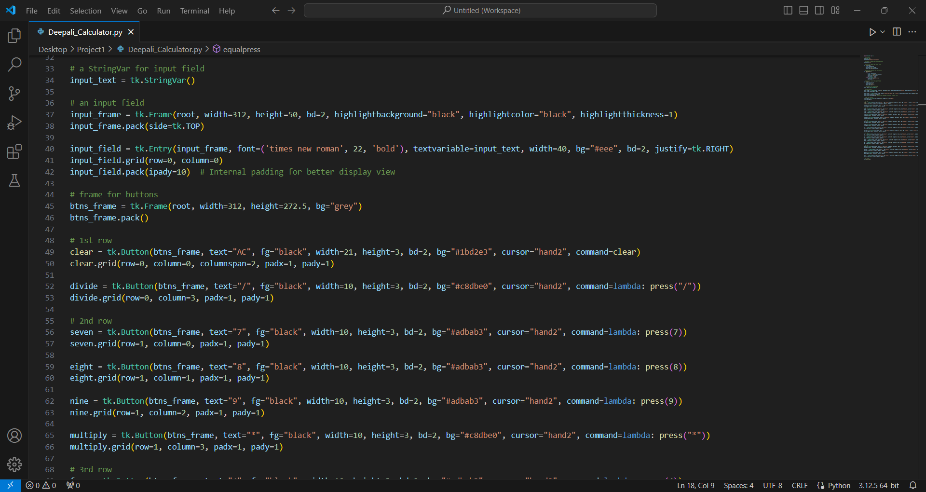

Slide 7
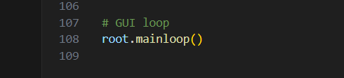
Step 4 Creating the Main Loop
1. Use `root.mainloop()` to start the Tkinter event loop.
2. This keeps the application running and responsive to user input until closed.

Slide 8
Code Overview
The complete code integrates all these steps to form a functional calculator application.
Key elements include event handling for button clicks and dynamic updates to the display.

Slide 9
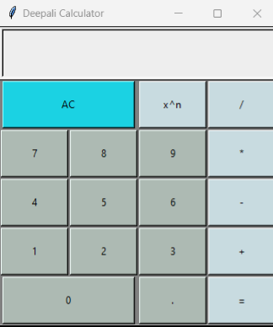

Slide 10
Conclusion
We created a basic calculator application using Python's Tkinter library.
The app demonstrates fundamental concepts in GUI development, including widget management, event handling, and user interaction.

